Slide 1
Andrew Joiner, General Manager, HP Software, Autonomy, Emerging Technology
Colin Mahony, General Manager, HP Software, Vertica

Slide 2
Big data analytics: today’s gold rush
Andrew Joiner, Colin Mahony / December 5, 2012

Slide 3

In Data There is Gold
In data, there is gold
Notes:
Key Thoughts:
Data is everywhere!!! – Data is the new black – but information is GOLD!
There is value for those able to extract information from the data in a way that enables them to engage, drive an outcome, enhance an experience, etc
There is no vertical / company size, etc. excluded from the big data phenomenon
Big Data is here today – get on the bus or get run over by it (because your competition is engaging as we speak)..

Slide 4


Fundamental shift
For the first time in the IT industry, there is a fundamental shift from the “T” to the “I”: information management is the new source of competitive advantage.
© Copyright 2012 Hewlett-Packard Development Company, L.P. The information contained herein is subject to change without notice.

Slide 5


Accelerating innovation and time to value
kaggle
SolidFire
Pandora
Scribd.
Every 60 seconds
Music
iHandy
DocuSign
Amazon
SmugMug
SuperCam
Snapfish
salesforce.com
Urban
Finance
NetSuite
Xactly
Dragon Diction
AppFog
Parse
Travel
98,000+ tweets
Joyent
Plex Systems
UPS Mobile
LinkedIn
Reference
Taleo
DCC
eBay
Google
Facebook
Bromium
PingMe
Atlassian
Lifestyle
Manufacturing Projects
CCC
Hosting.com
Hyland
GoGrid
Splunk
695,000 status updates
Product Configurator
SAP
HP
Tata Communications
buzzd
Amazon Web Services
box.net
Sport
CRM
MRM
Quickbooks
Ariba
NetReach
Scanner Pro
LimeLight
Yandex
ScaleXtreme
Bills of Material
Engineering
Order Entry
NetDocuments
Zoho
Foursquare
cloudability
Games
SCM
Inventory
Datapipe
Alterian
Qvidian
Hootsuite
CloudSigma
Workbrain
Pinterest
11million instant messages
Burroughs
Quality Control
EMC
OpenText
CyberShift
nebula
HP ePrint
Twitter
IBM
Hitachi
HCM
Workscape
Sage
Cost Management
Unisys
Mobile, Social,
Big Data & The Cloud
Zettabytes
Mainframe
Kilobytes
Client/Server Megabytes
The Internet Gigabytes
698,445 Google searches
NEC
Bull
ERP
Cash Management
HCM
Microsoft
Xerox
Serif
SLI Systems
Zynga
168 million+ emails sent
Fijitsu
Time and Expense
Fixed Assets
OpSource
Avid
Elemica
iSchedule
Workday
Baidu
Costing
Accounts Receivable
ADP VirtualEdge
Yahoo!
SCM
Khan Academy
Navigation
Yandex
Mixi
Photo & Video
Payroll
Billing
Adobe
Corel
CyberShift
PaperHost
Renren
Zillabyte
Heroku
Yammer
Training
Activity Management
PLM
Yahoo
Kinaxis
Education
SuccessFactors
Entertainment
Viber
1,820TB of data created
Microsoft
SugarCRM
Atlassian
Answers.com
Sales tracking & Marketing
Rostering
PPM
Saba
Sonar6
BrainPOP
RightScale
Social Networking
Time & Attendance
Service
Kenexa
Quadrem
Sonar6
MobileFrame.com
YouTube
CYworld
Commissions
Database
Saba
myHomework
Business
Jive Software
Claim Processing
Intacct
Softscape
NetSuite
Fring
Toggl
News
Tumblr.
Qzone
217 new mobile web users
Data Warehousing
Cornerstone onDemand
Exact Online
Cookie Doodle
Xing
Amazon
dotCloud
Softscape
FinancialForce.com
MailChimp
New Relic
Mozy
PingMe
IntraLinks
Volusion
Ah! Fasion Girl
Utilities
Zynga
Yottabytes
Associatedcontent
BeyondCore
SmugMug
Atlassian
MobilieIron
Productivity
Rackspace
Flickr
Fed Ex Mobile
TripIt
Paint.NET
Twitter
Notes:
Every 7-10 years, technology delivery undergoes a tectonic shift; one that opens up new business and access models. A shift that changes the way technology is consumed and the value that it can bring. A change in what is possible. A removal of inhibitors that unleash the power of innovation.
Today, mobility, social, big data, and the advent of cloud computing are representative of such shifts offering a new means for IT to help organizations accelerate progress towards solving their most pressing challenges (including speeding innovation, enhancing agility, improving financial management). These shifts can unleash the power of IT to not only support but help shape the business.

Slide 6
Information from the internet of things
10²⁷
We have gone beyond the decimal system
Today data scientist uses Yottabytes to describe how much government data the NSA or FBI have on people altogether.
In the near future, Brontobyte will be the measurement to describe the type of sensor data that will be generated from the IoT (Internet of Things)
Brontobyte
This will be our digital universe tomorrow…
10²⁴
10²¹
Yottabyte
Zettabyte
This is our digital universe today = 250 trillion of DVDs
10¹⁸
1.3 ZB of network traffic by 2016
Exabyte
10¹⁵
1 EB of data is created on the internet each day = 250 million DVDs worth of information.
The proposed Square Kilometer Array telescope will generated an EB of data per day
Petabyte
10¹²
The CERN Large Hadron Collider generates 1PB per second
Terabyte
10⁹
500TB of new data per day are ingested in Facebook databases
Gigabyte
10⁶
Megabyte

Slide 7
CeNSE – Central Nervous System for the Earth
A real world example: Networks of billions of low-cost, self-powered, nano-scale sensors
Airline
Department of Transportation
Airframe Integrity
Retailer
Passenger Comfort
Home Automation & Security
Security Service
Tsunami Warning System
Personal Sensor Subnet
Real Time Traffic Conditions
Large Structure Integrity
Merchandise Tracking
Auto Maker
Oil Exploration & Production
Weather Service
Climate Monitoring
Wildlife Research
Wildlife Tracking
Oil and Gas
Wireless Carrier
Notes:
Add to that the semi-structured (machine-generated) data, which is the newest contributor to the data explosion. A vivid example is the CeNSE based Sensor Networks. In 2007, HP Labs proposed an ambitious research agenda to build environmental sensors to act as the receptors, or nerve endings, for the Central Nervous System for the Earth (CeNSE). These receptors are based upon nanotechnologies to detect mechanical, electrical and optical signatures at unprecedented sensitivity levels that define the state of the art. These nano-sensors can be used to detect vibrations, motion, sound, color, light, humidity, chemical composition and many other characteristics of their environment. These sensors can revolutionize the search for new oil reservoirs, building and bridge structural integrity, merchandise tracking and authentication, food and water safety, energy use and optimization, healthcare monitoring and cost savings, and climate and environmental monitoring.
These nano-sensors and the sensing ecosystem for collecting, communicating, storing and analyzing data, position HP as the market leader in delivering end-to-end Big Data analytics solutions for cyber-physical systems. Two key sensors are the Richter MEMS physical sensors and the SERS nano-finger chemical and biological sensors. The Richter MEMS accelerometer is 1000x more sensitive than competitive physical sensors and can be used to listen and to feel the cyber-physical world. The SERS nano-finger chemical and biological sensor is 1 million times more sensitive than competition can taste and smell the cyber-physical world.

Slide 8
CeNSE – Central Nervous System for the Earth
Large sensor networks are being designed and deployed by leading HP customers
The data volumes being generated 70-100,000,000,000,000 bytes per day 25,000,000,000,000,000,000 bytes per year
Data being generated on the back-end network to configure, monitor and manage 1,000,000,000,000 bytes per day
A trillion sensors by 2030, roughly 150 sensors for every person on earth
As sensor networks grow to this scale that equates to one million times more storage and processing will be required.
Notes:
Other large sensor networks are being designed and deployed by leading HP customers. For example, the Richter physical sensor is in a trial that will ultimately involve up to one million sensors. At that scale, the sensors generate between 70-100 terabytes of data per day. That data must be communicated through wireless networks to the cloud for storage and analytics. That’s more than 25 petabytes of data in one year! The back-end network to configure, monitor and manage the sensors also generates about 1 terabyte per day as well in addition to the mainline sensor application.
Today, sensors are collecting information on virtually every aspect of daily life, including: wireless telemetry, energy meters, weather data, biological & chemical experiments, and device location. This is in addition to the already significant IT data that organizations’ equipment already generates – e.g. logs, monitoring information, and security flows. Humans and machines are generating data so quickly that they dwarf the growth in traditional, structured information.
As we look into the future, researchers at HP Labs estimate that by the year 2030 there may be up to a trillion sensors deployed and monitoring the cyber-physical world. A trillion sensors imply about one sensor every 10 square feet covering the US or 150 sensors per person on the planet. And as sensor networks grow to this scale, it means one million times more storage and processing will be required.
So as you can see, the real customer challenge isn’t traditional capacity growth. The challenge is the massive capacity growth in types of information they’ve never truly leveraged, as that data becomes vital to their futures.

Slide 9
The challenges of information
Variety, velocity, volume, time to value
75%
of currently deployed data warehouses will fail to include unstructured data support (by 2016)² to meet new information velocity and complexity of demands
86%
of corporations cannot deliver the right information, at right time to support enterprise outcomes all of the time³
90%
of digital content created by 2015 will be unstructured data types ¹
48%
Worldwide information volume growth of digital content¹
¹Source: IDC Predictions 2012: Competing for 2020
²Source: Gartner - The State of Data Warehousing in 2012
³Source: Coleman Parkes Survey Nov 2012

Slide 10

Imagine a world where a conversation with your information drives actionable insight
Actionable insight across structured, semi-structured & unstructured data
Right time, enterprise-altering decision making
Accelerated Time to Value
Social Media
Video
Audio
“Do 40% more of this …”
Texts
Messages
Transactional
Data
Transactional
Data
Word, Excel
Logs
Clickstream Data
Logs
Clickstream Data
Images
Email
MGD
Actionable Insight Requires Analysis
of 100% of Information
Notes:
Imagine a world where a conversation with your information, in near real time, gives you actionable insight that enables personalized consumer experiences, new medical innovations, proactive financial trading strategies, new product ideas based on consumer behaviors and trends, and so much more. While this would be priceless in terms of value, imagine a world where the total cost of ownership was actually dramatically lower than the limited systems of today.

Slide 11
Return on Information How do you measure value?
Data sources
Data volumes
Depth of analytics
Role of users
Data value
=
Time
ROI
Return on Information
Delivery cost
Hardware
Software
Services
Support
Maximized with HP
Notes:
Over the coming years, an organization’s Return on Information will be the single most important measure of success. Return on Information is the value that enterprises or governments derive from their investments in storing, managing, analyzing, and acting upon information.
Return on Information is a strategic view of investment. It is the higher order measurement beyond the traditional ROI. Information value, by definition, is the reason for all Information Technology investment.
There are three key factors in Return on Information: insight, time to value, and cost.
Insight is the value extracted from all types of information; and the value of that insight is derived from the percentage of data that an organization analyzes, how deeply it analyzes that data, and how many people benefit from the analytics. Insight is about analyzing 100 percent of the data and ensuring that everybody who needs it understands what should drive critical enterprise decisions. The more right-time actionable insight, the greater the value an organization derives from its information.
Time to value is the speed at which information insight is made available. We are in a new world which demands near-instant decisions on a 24x7x365 basis. As a result time to value has never been more important. The right people need the right information at the right time to maximize the value of the information.
Total cost is how much enterprises spend on their information. Total cost comprises the Capital and Operational expenditures (CapEx, OpEx) required to store, manage, and analyze data. Many organizations don’t realize that, when they’re not managing or analyzing 100 percent of their data, they’re still paying ever-increasing costs to store and manage inert data. Therefore, they can often reduce their total costs by just actively managing their information.
The three components of Return on Information translate to a simple equation. The value derived from actionable insight is inversely proportional to (divided by) the time to value; the sooner the insight is delivered, the greater the data value. Return on Information is the data value divided by the total cost.

Slide 12















Extreme information challenges
Big data: volume, velocity, variety and complexity
Extreme information generated for mobile devices, social media, sensors, and even ‘flash mobs’ are affecting our governments, enterprises and personal lives in new and interesting ways
Pattern-based strategy
Social computing
Context-aware computing
Velocity
Volume
Big data
Variety
Complexity
Information sources
Social Media
Video
Audio
Email
Texts
Mobile
Transactional
Data
Documents
IT/OT
Search Engine
Images
Notes:
SLIDE OBJECTIVE – to highlight the presence of Extreme Information and its implications
KEY POINTS
We highlighted earlier the tremendous VOLUME of information being created. But Gartner and others also have shared their findings and observations around the emergence of ‘Extreme Information’, which also involves three other complicating dimensions to information.
Along with Volume, there’s the VELOCITY. Relevant, valuable information for an enterprise is coming at such a torrential pace it’s become a real-time phenomenon requiring real-time capabilities.
Next is VARIETY – which you can see from just the subset of information sources shown here.
Finally there’s the COMPLEXITY of where it lives and moves. From server to cloud to hybrid to device and back and forth.
TRANSITION – the good news, however, is that enterprises are winning…

Slide 13

Legacy architectures were built for a different world
Yesterday’s data warehouse and analytic infrastructure
Proprietary
Expensive
Centralised, monolithic
Process laden
Batch
Summary
Slow
Notes:
Traditional BI environments are often designed with proprietary technology that is expensive. They were not designed to provide the speed and agility required to integrate the variety of data types we are dealing with today, analyze data in real-time, and generate the intelligence required by the fast-paced demands of today’s changing business environment.
Where near real time, iterative, automated and low cost data analytics are not required, these legacy platforms will likely meet business requirements. The question is … is that the world that you live in?

Slide 14




Why is processing human information different?
Human Information is made up of ideas, is diverse, and has context.
Ideas don’t exactly match like data does: they have distance.
Human Information is not static – it’s dynamic and lives everywhere.
Legacy techniques have all fallen short.
Social Media
Video
Audio
Email
Texts
Mobile
Transactional Data
Documents
Search Engine
Images
IT/OT

Slide 15

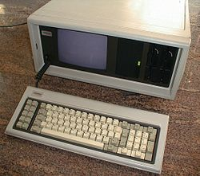
Putting big data in perspective: January 1983
Michael Jackson had the chart topper “Billie Jean” on LP
Compaq’s first portable computer shipped!
TWO real floppy drives and 128KB memory

Slide 16

Can you imagine a zettabyte (ZB) today?
1,000,000,000,000,000,000,000 bytes
= 1000⁷ bytes
= 10²¹ bytes
=1 trillion gigabytes
=1 billion terabytes
=1 million petabytes

Slide 17
HP delivers core engines for performance
Closed-loop performance systems for IT and business professionals
Desired state
Big data indexing and understanding
Real-time analytics
High volume operational data
Dynamic dependency map
Act
See
Continuous innovation & execution
IDOL
Vertica
Logger
RTSM
Conceptual and contextual understanding of all content
Analysing unlimited data interactively in real-time
Machine data –– event stream and logs
Run-time application and business service model
Understand
Notes:
No matter what your idea (or desired state), to achieve it, you need closed loop performance systems that deliver real-time actionable intelligence:
See – what’s happening across your entire environment
Understand – analyze and make sense of all the information and
Act – execute with best practices (whether our best practices we package from our deep experience, or yours)
And continuously improve.
At the core of our Performance Systems are a set of powerful engines, that together with the surrounding software are protected by over 2000 patents and patents pending.
IDOL
IDOL indexes a vast array of human and machine information and uses its patented pattern-matching technology to form a conceptual and contextual understanding of all content, independent of language or format, thereby enabling searches to be performed conceptually. Since conceptual search can find information based on words not located in the document, it does not fall prey to the limitations of legacy methods.
Vertica Analytics Platform
Our analytics platform leverages Columnar Storage & Execution »Perform queries 50x-1000x faster than traditional data bases
HP ArcSight Logger and Correlation Optimized Retention and Retrieval (CORR) Engine
Engine is a breakthrough technology that delivers orders of magnitude improvement in log correlation and storage, helping security administrators thwart the complex threats they face today.
You can detect, log and make sense of millions of daily security events across your enterprise whether a badge swipe, someone logging into a system or a hacker attack.
RTSM = Run time service model
HP’s unique Run-time Service Model maps business processes to applications and their supporting software and infrastructure, so that even in this complex world of business processes and applications running on multiple services that can run anywhere, they’re performing to your specifications at levels – from the infrastructure to the user interaction.
***
DETAIL FOR BACKGROUND
IDOL
Conceptual Search
IDOL uses its patented pattern-matching technology to form a conceptual and contextual understanding of all content, independent of language or format, thereby enabling searches to be performed conceptually. Since conceptual search can find information based on words not located in the document, it does not fall prey to the limitations of legacy methods.
Advanced Conceptual Retrieval
IDOL solutions offer higher degrees of accuracy and sophistication, using a scalable technology that recognizes concepts. Putting information into context, this unique IDOL differentiator provides powerful conceptual retrieval features, including:
Natural Language Retrieval
IDOL accepts sample data as input (a sentence, paragraph or page of text, or the derived contextual information of an audio or speech snippet) and returns references to conceptually related documents ranked by relevance or contextual distance.
Query By Example
Users can submit sample data as input and IDOL returns references to conceptually related documents ranked by relevance or contextual distance.
Refine By Example
Users have the ability to refine by example. Based on the results of a natural language query, users can quickly refine their search by selecting refined examples to precisely focus on the context they require.
Relevance Ranking
In evaluating all types of queries, IDOL employs complex algorithms based on a combination of Information Theory and Bayesian methods to automatically weight and rank documents by statistical relevance. In doing so, it makes use of theoretic values calculated dynamically for all concepts on indexing, allowing the relevance of content to be evaluated. In practice, relevance can be seen as a measure of the conceptual overlap between the query text and the text within a document. Additionally, IDOL allows administrators to manipulate the relevance of query results in several ways:
Setting up a field process - users modify IDOL's configuration file, raising the percentage relevance of results according to the number of times that terms in specified fields match the terms in the query
Using BIAS - users can employ the BIAS field specifier to dynamically boost the percentage relevance of a query's results according to the numerical proximity of a specified field to a given value
Using Multipliers - users can multiply the weights of individual query terms in order to boost the relevance of results that match these terms accordingly
Key Benefits
Improves user experience by ordering search results in formats that better match expectations
Relevance can be customized by administrators to suit business needs and employee roles
Properly implemented relevancy ranking can result in productivity gains and cost savings
Vertica Analytics Platform
Unlike most other data warehouse vendors that are attempting to retrofit 21st century technology into their decades old infrastructure, Vertica was designed and built since its inception for today’s most demanding analytic workloads. Furthermore, each Vertica component is able to take full-advantage of the others by design.
Key Features of the Vertica Analytics Platform
Real-Time Query & Loading »Capture the time value of data by continuously loading information, while simultaneously allowing immediate access for rich analytics.
Advanced In-Database Analytics »Ever growing library of features and functions to explore and process more data closer to the CPU cores without the need to extract.
Database Designer & Administration Tools »Powerful setup, tuning and control with minimal administration effort. Can make continual improvements while the system remains online.
Columnar Storage & Execution »Perform queries 50x-1000x faster by eliminating costly disk I/O without the hassle and overhead of indexes and materialized views.
Aggressive Data Compression »Accomplish more with less CAPX, while delivering superior performance with our engine that operates on compressed data.
Scale-Out MPP Architecture »Vertica automatically scales linearly and limitlessly by just adding industry-standard x86 servers to the grid Automatic High Availability »Runs non-stop with automatic redundancy, failover and recovery optimized to deliver superior query performance as well
Optimizer, Execution Engine & Workload Management »Get maximum performance without worrying about the details of how it gets done. Users just think about questions, we deliver answers, fast.
Native BI, ETL, & Hadoop/MapReduce Integration »Seamless integration with a robust and ever growing ecosystem of analytics solutions.
HP ArcSight’s Correlation Optimized Retention and Retrieval (CORR)
Engine is a breakthrough technology that delivers orders of magnitude improvement in log correlation and storage, helping security administrators thwart the complex threats they face today.
CORR uniquely
• Detect more incidents - the new architecture will allow event correlation rates of up to 5x the current performance using the same hardware.
• Address more data the new architecture will enable storage capacity of up to 10x the current capacity for correlated events using the same disk space.
• Operate more efficiently - the use of a common data store allows both the real-time correlation application and the log management application to use the same set of data, providing a seamless workflow that includes detection, alerting, forensic analysis and reporting.
Run time service model
Finally, the rapidly changing IT dependencies of the borderless enterprise need to be dynamically discovered and mapped to ensure that availability, performance, compliance and security can be maintained with confidence and control.
HP’s unique Run-time Service Model maps business processes to applications and their supporting software and infrastructure. Business assets include business services, processes, and activities such as services that a business provides to another business (or one organization provides to another within a business) and that an IT organization provides to support business services or IT operations. For example a business service typically has an associated end user or customer, a business application, and a SLA. Examples include payment processing, backup and recovery, and self-service help desk.
Because configuration management differs dramatically from operations management, unlike other vendors, HP separates traditional Configuration Management Systems (also know as a CMDB) from the Run-time Service Model.
By doing so, each one is used more effectively, and based on their applicable and different use cases, disruption of one does not impact the other, and each can be upgraded independently. The HP BSM Run-time Service Model, federates with the HP CMS solution—in addition to third-party CMDB solutions—so that it can easily be leveraged across the enterprise.

Slide 18






IDOL: 500 functions and 400 connectors
Conceptual distance understanding
Meaning extraction
Meets most demanding security requirement
Language agnostic
Supports over 1,000 file types and 400 content repositories
Automates processes in real time
Social, audio, video, text
Distributable
Real time
Manage in place
Petabyte and beyond scalability
OEM
Cloud
Interfaces
Mobile
SOA & IAS
Intelligent Data Operating Layer
Unstructured
XML and structured
Audio
Video
People
ACI
Operational
repositories
Archive
Federated
Desktop
Web
Rich media

Slide 19
Vertica: 50 – 1000x faster
Columnar storage and execution
Designed for answers from the very first line of code
Clustering
Achieve best data query performance with unique Vertica column store
Compression
Add resources on the fly with linear scaling on the grid, commodity hardware
Database design Automated performance tuning
Advanced analytics
Time-series, geospatial, click-stream and an SDK for more
Continuous performance
Store more data, provide more views, 90% less storage required
Query and load 24x7 with zero administration
Notes:
A vision is great, but technology is makes our vision a reality. Vertica’s innovative technology makes the difference because it was designed from the very first line of code for the new demands of near real time data analytics.
Relational Software platform to store, manage, and analyze information
Native COLUMNAR architecture is core, and enables better joins and fundamentally faster analytics
Load and query simultaneously, dramatically increasing the velocity
MPP- Highly scalable, elastic and fully PARALLEL, with commodity hardware and 90% less storage due to compression technology
SQL & NoSQL analytics capabilities
Simple installation & use with automatic setup and tuning

Slide 20

Data is always changing, multilingual and no longer just about text
1
Audio and video are imperatives

Slide 21

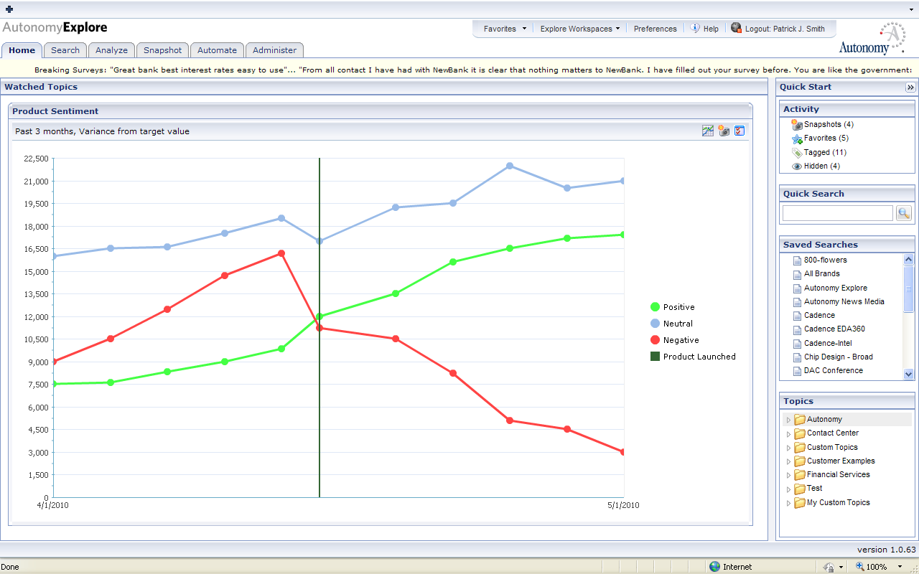
Sentiment in speech and other rich assets
Preferences
Emotion
Cross talk
Patterns
Sentiment
Intent
Risks
Notes:
Understands the meaning of speech content in audio, video, and customer interactions, regardless of language or format
Automates the delivery of relevant customer intelligence to all pertinent business units
Uncovers trends and issues that definitively impact business performance and operations
Supports legacy approaches such as phoneme processing and word spotting in addition to conceptual analysis

Slide 22

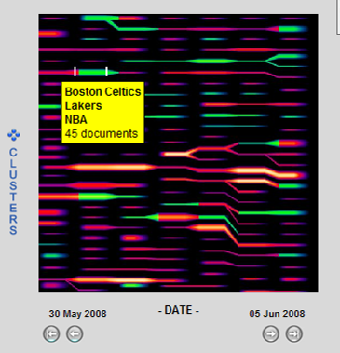
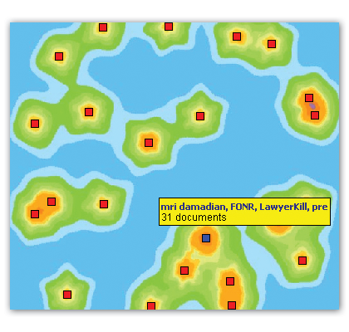
Apparel
Computers
Product performance issues
Correlation is key
Notes:
PIC5 (grouped documents)
"So for example we might see groups based on off-balance sheet trading entities... side letters.... product performance issues.... procurement failures.... and even sub-sets of these concepts and relationships such as one of our customer found, which was employees using credit cards to order items that procurement failures forced them to do themselves!

Slide 23

Manage in place is the ONLY viable architecture
2

Slide 24

Too many insights are possible
3
You must test…optimise and hypothesise

Slide 25

Predicting the future is more valuable than understanding the past Both are critical
4

Slide 26

Today’s organizations move from “Return on Infrastructure” to “Return on Information”
5

Slide 27













Powerful enterprise software portfolio
Market-leading software to address top industry trends and customer priorities
Meaning-based computing
6th largest software company in the world
Big data analytics
Customers in 94% of the Fortune 100
Enterprise security
About 50,000 customers
Enterprise View
Cloud management
Data
Protector
Delivered innovation
across entire software portfolio in the past two years
Service
Virtualization
Cloud Service Automation
IT management
Application Lifecycle Management
#1 or #2 in key enterprise software markets
OpenView
Notes:
Here you can see how we have built the portfolio through combined organic innovation and inorganic acquisition.
We are the 6th largest software company in the world serving almost the entire Fortune 100
Delivering key innovation
Positioning us as #1 and #2 in key enterprise software markets

Slide 28
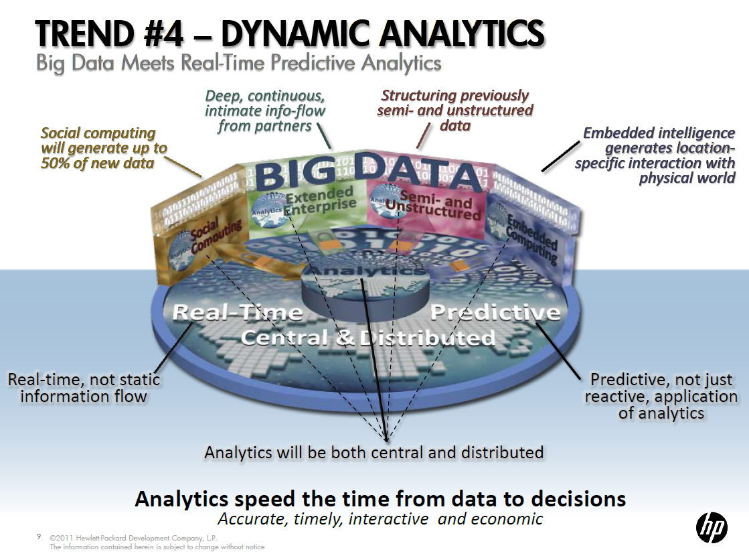
Why HP matters: people, technology, & trust

Slide 29
What answers do you need?
Notes:
At Vertica, we are changing the focus from the data to the answers. What answers do you need that will make a difference for your business and for your customers?

Slide 30

Download Now
Get the Mobile App
Download content from this session with the free Mobile App at:
m.hp.com/events

Slide 31
Find out more
Visit these demos
After the event
Vertica Analytics Platform: Scalable DB with Rapid Time-to-value, Demo #614
Autonomy Social Media and Customer Analytics, Demo #742
Vertica Analytics Platform, Demo #745
Autonomy IDOL, Demo #746
Watch replays of HP Discover at: www.hp.com/go/discover
Contact your sales rep
Visit: www.autonomy.com
Visit: www.vertica.com
Your feedback is important to us. Please take a few minutes to complete the session survey.

Slide 32
Thank you

Slide 33
声明：
所有的版权属于原有公司，文件均来自公开渠道
此文件仅供学习使用，任何人不得进行以此为商业目的的行为
如有疑问，请立即删除
学习世界五百强和咨询公司PPT课程请访问如下网站搜索：“司马懿”
百度传课：司马懿PPT学校
网易学堂：司马懿PPT学校
知乎： 司马懿PPT学校
访问地址
https://www.chuanke.com
访问地址
https://study.163.com
访问地址
https://www.zhiu.com

